Slide 1
WEBINAR Revenue validation

Slide 2
Agenda
Revenue Validation Overview
Revenue Validation Process.
Apple - App Store Configuration
Transaction Event
QA
Data Structure
Queries / Segments / Filters
Questions….

Slide 3
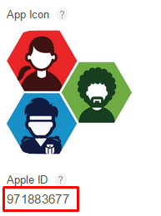
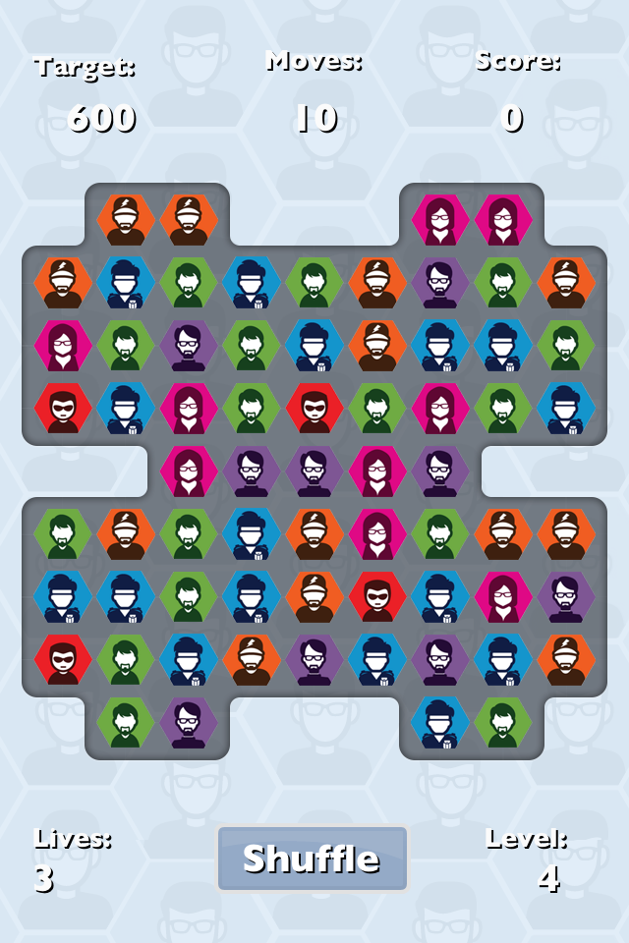
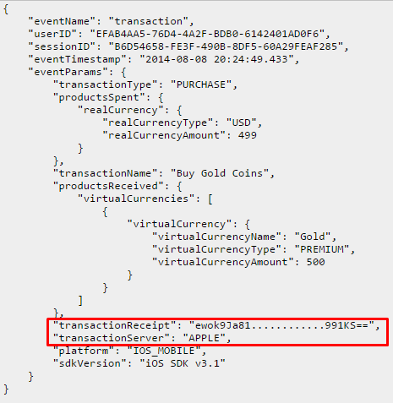
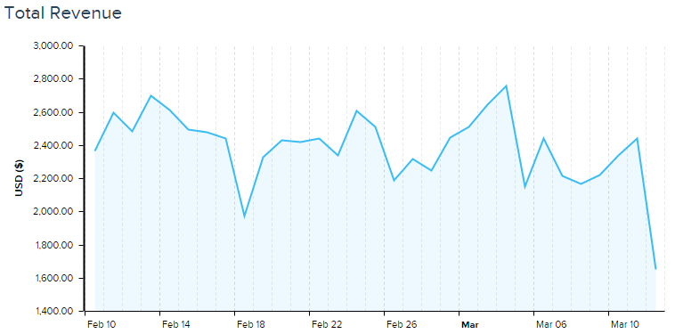
Revenue Validation Process
deltaDNA platform
Apple Receipt Validation Service
Game ID saved on platform
Valid Transaction ?
Validation Result
Game sends transaction event to deltaDNA
Invalid revenue excluded from charts
transactionReceipt and transactionServer parameters

Slide 4
Overview
Server to Server revenue validation
Only genuine, verified revenue displayed in dashboards
Supports Apple App Store / Amazon
Not Currently supported on Google Play. Due to security concerns with Google implementation
Data can be analysed, segmented to identify hackers. Hackers could be targeted with Engage to modify their game behaviour

Slide 5
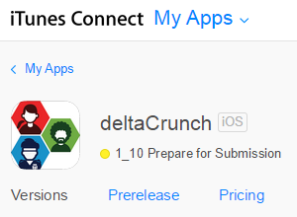
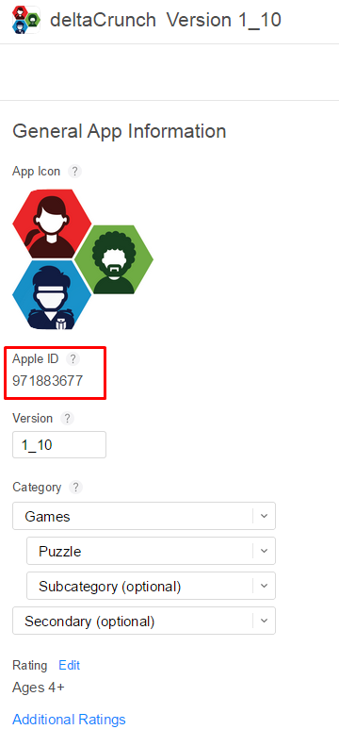
Apple - App Store Configuration
Add App Store details to your Game Details page
Apple Validation Service URL :: https://buy.itunes.apple.com/verifyReceipt
Apple ID for game :: e.g. 971883677

Slide 6
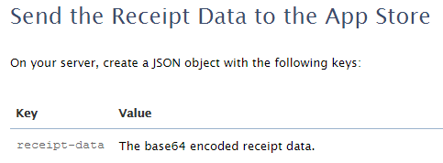
Your Transaction Event
Transaction event from client device includes - transactionServer - transactionReceipt
Transaction receipt is Base 64 Encoded receipt that was returned from Apple IAP
Validating Receipts With the App Store
https://developer.apple.com/library/ios/releasenotes/General/ValidateAppStoreReceipt/Chapters/ValidateRemotely.html#//apple_ref/doc/uid/TP40010573-CH104-SW1

Slide 7
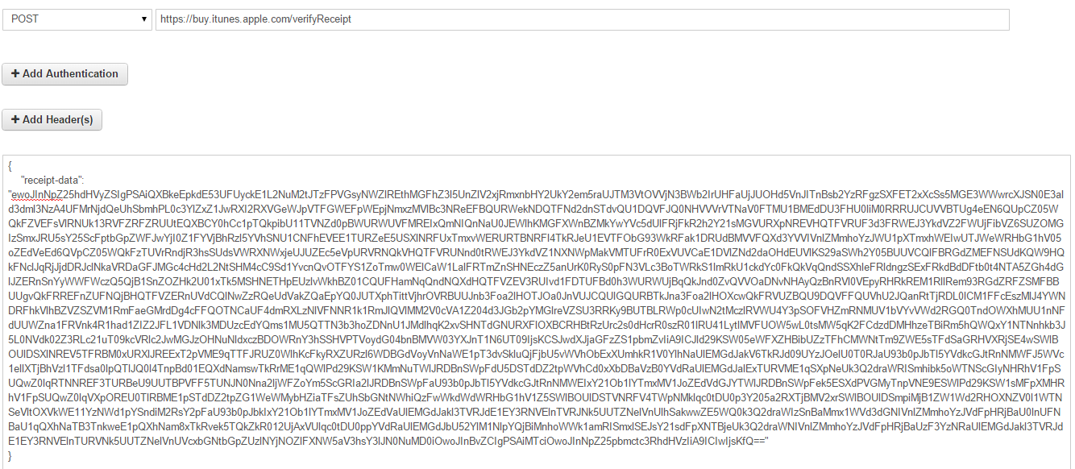
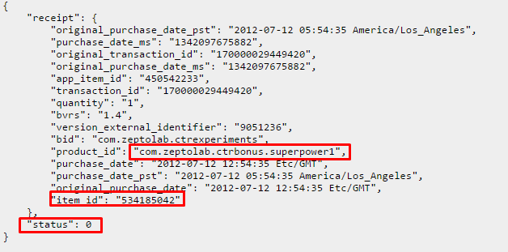
QA
Revenue Validation on DEV should be manually confirmed - Apple Sandbox service doesn’t reveal Game ID in receipt
Check using something like http://hurl.it
Validating Receipts With the App Store
Failed validation ! – valid receipt from a different game!
https://developer.apple.com/library/ios/releasenotes/General/ValidateAppStoreReceipt/Chapters/ValidateRemotely.html#//apple_ref/doc/uid/TP40010573-CH104-SW1

Slide 8
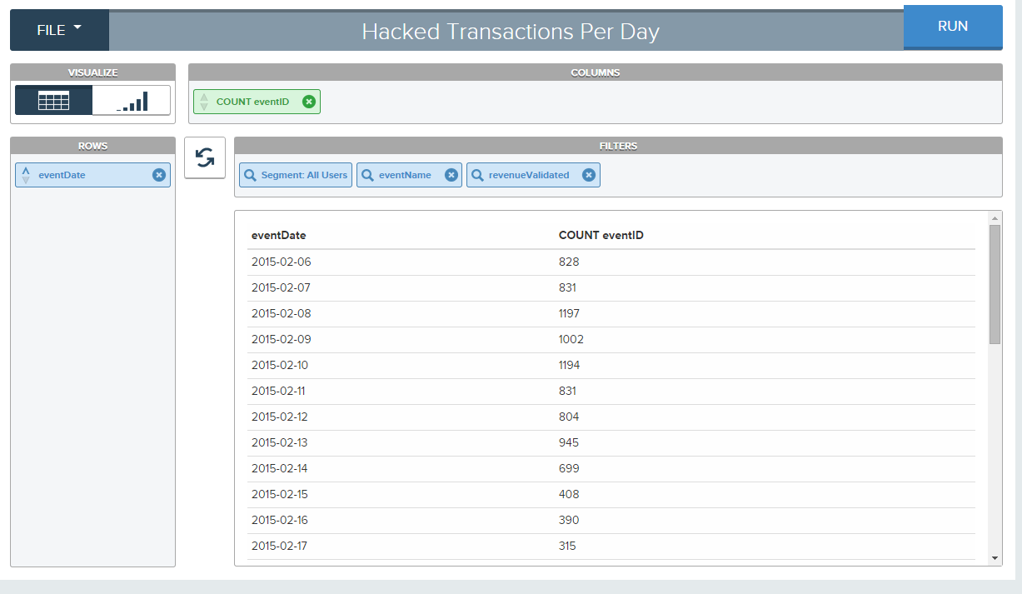
Data Structure
RevenueValidated flag automatically appended to transaction events by event validation processor.
RevenueValidated
0 – no validation performed
1 – validated successfully
2 – failed validation
Only revenue validated 0 and 1 is displayed in dashboards

Slide 9
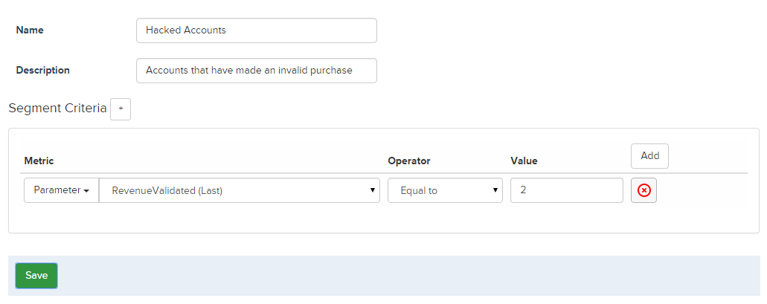
Filters & Segments
Build a segment based on RevenueValidated metric = 2 and you can isolate users who have performed an invalid transaction.
Use this segment to filter Measure dashboards or Analyze tools like Slice and Dice
With Targeting you could even modify game behaviour for Hacked Accounts!

